Slide 1
CPU SCHEDULING ALGORITHM FOR IMPLEMENTING MULTIFEEDBACK QUEUE

Slide 2

Team Members:
M. Karthikeya-AP21110010605,
Y. Sai Bharath-AP21110010606,
Y. Ramana-AP21110010607.

Slide 3

Abstract:
In CPU scheduling various algorithms exist like FCFS (First come first serve), SJF (Shortest job first), SRTF (Shortest remaining time first), Priority Scheduling, Round Robin (RR), MLQ (Multilevel queue), MLFQ (Multilevel feedback queue) scheduling. Multilevel Feedback Queue (MLFQ) algorithm allows the switching of processes between queues depending on their burst time. The processes switch to the next queue when burst time is greater than time quantum. Each queue can define its own scheduling policy.
In a multilevel queue-scheduling algorithm, processes are permanently assigned to a queue on entry to the system. Processes do not move between queues. This setup has the advantage of low scheduling overhead, but the disadvantage of being inflexible.
Multilevel feedback queue scheduling, however, allows a process to move between queues. The idea is to separate processes with different CPU-burst characteristics. If a process uses too much CPU time, it will be moved to a lower-priority queue. Similarly, a process that waits too long in a lower-priority queue may be moved to a higher-priority queue. This form of aging prevents starvation.

Slide 4
01
04
CODE:
SYSTEM REQUIREMENTS:
02
05
OUTPUT:
ALGORITHM:
03
INTRODUCTION:

Slide 5

01
INTRODUCTION:

Slide 6
The efficiency of multitasking operating systems primarily depends on the scheduling algorithm used by the CPU. The selection of scheduling policy affects the process response time (amount of time taken by process to get CPU), average waiting time (amount of time a process waits for its complete execution) and may also have impact on starvation (it occurred if a process is not getting CPU for a long time). Currently, many CPU scheduling algorithms are existing like FCFS, SJF, SRTF, Round Robin Scheduling, Priority Scheduling, MLQ and MLFQ. MLFQ may be one of most powerful strategy for CPU scheduling. It is an extended version of MLQ scheduling algorithm also Multilevel Queue Scheduling is result of combination of scheduling algorithms like FCFS and RR scheduling algorithms.

Slide 7
02
SYSTEM REQUIREMENTS:

Slide 8

SOFTWARE REQUIREMENTS :
Language used: C
IDE: Dev C++
HARDWARE REQUIRMENTS :
processor type, memory size, available disk space, and additional .
Operating System: Linux
Hard Disk: 1 Tb (minimum)
Processor: i3 (minimum)

Slide 9
03
ALGORITHM:

Slide 10
Start
Divide the processes into several queues, each with a different priority level. The first queue will have the highest priority, and subsequent queues will have lower priorities.
Assign a time slice to each queue. The first queue will have the shortest time slice, and subsequent queues will have longer time slices.
When a process arrives, it is placed in the highest-priority queue.
If a process exceeds its time slice in a queue, it is moved to the next lower-priority queue.
If a process is blocked for I/O or waiting for an event, it is moved to the lowest-priority queue.
If a process completes its execution, it leaves the system.

Slide 11
When a higher-priority process arrives, it preempts a lower-priority process.
Repeat steps 3-7 until all processes have completed their execution.
Stop

Slide 12
04
CODE:

Slide 13
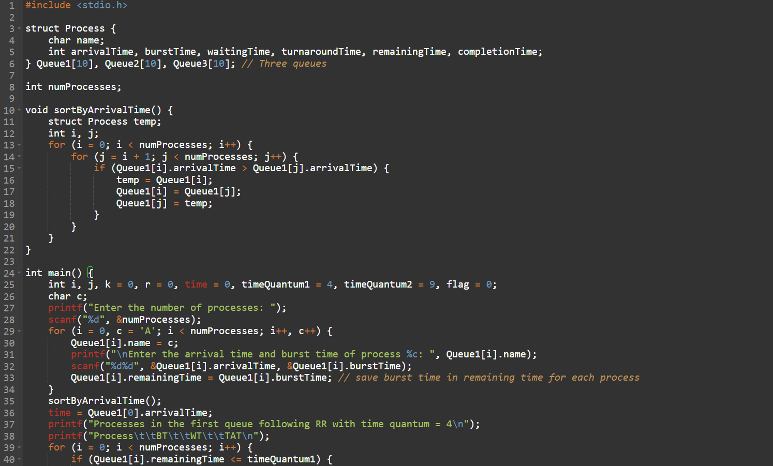

Slide 14
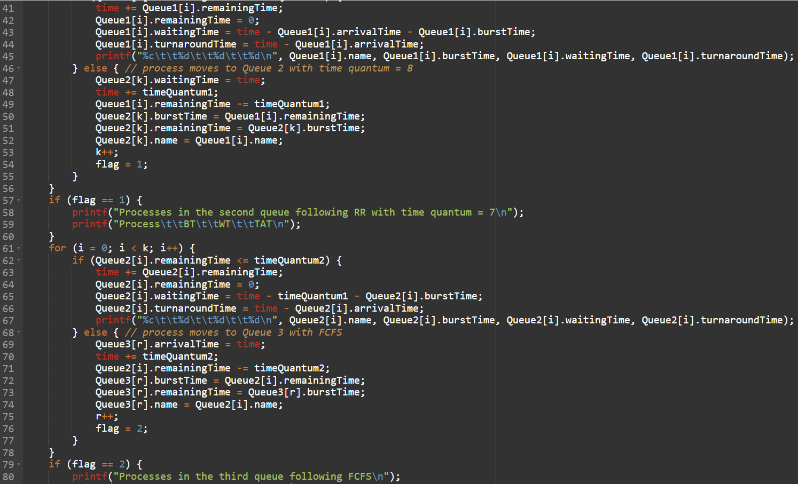

Slide 15
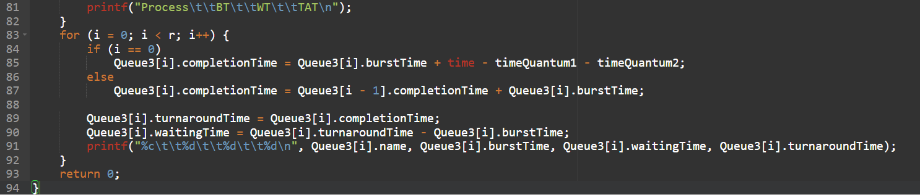

Slide 16

05
OUTPUT:

Slide 17
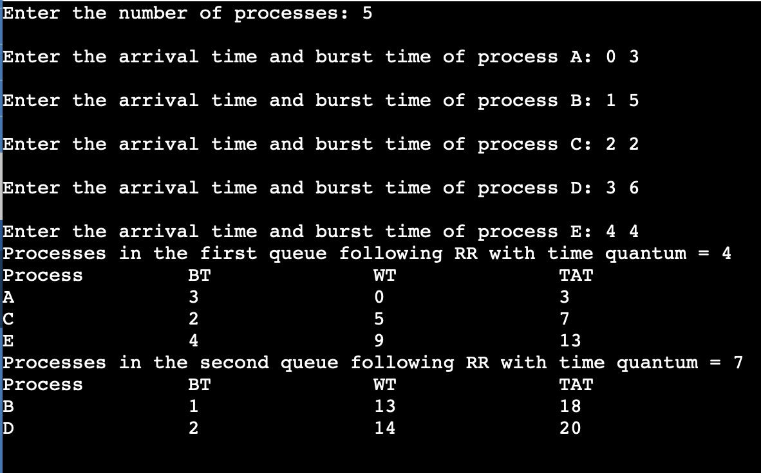

Slide 18

CONCLUSION

Slide 19
The definition of a multilevel feedback queue scheduler makes it the most general CPU-scheduling algorithm. It can be configured to match a specific system under design. Unfortunately, it also requires some means of selecting values for all the parameters to define the best scheduler. Although a multilevel feedback queue is the most general scheme, it is also the most complex.
Following are some points to understand the need for such complex scheduling:
This scheduling is more flexible than Multilevel queue scheduling.
This algorithm helps in reducing the response time.

Slide 20
THANKS!
THANKS!

